Slide 1
IDE 401: Integrating Technology Into Instruction III
2021
Unit 1 Spring 2021
Lei Wang & Amber Walton
IDD&E

Slide 2
Agenda
1
Introductions
2
Syllabus / Blackboard Overview
3
Initial Tech Portfolio Website
4
Assignments
5
TPACK
6
Technology station #1
7
Technology Design Case #1

Slide 3
Learning objectives:
By the end of this class, learners will be able to:
identify methods of integrating technology that can be used for instruction.
describe a technology integration framework-TPACK.
classify the trends of integrating technology into instruction in K-12 classrooms.
analyze how visualization can be formed.
apply the visualization tools to their lesson plan.

Slide 4

Notes:
This flyer includes an example of a word cloud.

Slide 5

IDD&E Lei Wang & Amber Walton 2021
Notes:
This business card uses examples of musical notation for its word cloud.

Slide 6
What is a Word Cloud and Why is it Important?
A word cloud is a collection, or cluster, of words depicted in different sizes. The bigger and bolder the word appears, the more often it is mentioned within a given text and the more important it is.
Word clouds feature a stunning visualization format to highlight important textual data points.
Word cloud generators can help simplify this process.
Using a word cloud can make dull data sizzle and immediately convey crucial information.

Slide 7

Lei’s Word Cloud

Slide 8

Brainstorming
What is your favorite technology?
What technologies have you learned from IDE201 or IDE 301?
What technologies do you want to learn？
How are you going to use them?
Any other thoughts about educational technology trends that we can see today?

Slide 9
Tech Station #1 Visualization - Word Cloud -WordArt
Now it’s your turn!
GO TO: BLACKBOARD at https://blackboard.Syracuse.edu
LOG IN: using your SU NetID and password
GO TO: IDE401 class section.
CLICK ON: UNIT 1 menu item
OPEN: Tech Station #1 Visualization folder
CLICK: “Station: WordArt” under the folder
CONTINUE...

Slide 10
Tech Station #1 Visualization - Word Cloud -WordArt
Click on the WordArt link (https://wordart.com/).
Click on the green CREATE NOW button.
To enter text, click Import for typing your text; click Add for a single word or phrase.
Create a word cloud with at least 10 words to describe yourself and answers to the questions about technologies.
Under the SHAPES label, select a shape or click + Add image to paste or upload a picture of your choice (such as a baseball, etc).
Explore various options in FONTS, LAYOUT and STYLE.
Click Visualize to get your word cloud.
When you are satisfied with your image, click DOWNLOAD, then click Standard PNG or Standard JPEG to save it on desktop.
Upload it to the Blackboard – UNIT 1 – Discussion Board – Word Art-Self-introduction---click “Insert/Edit Image”---Click “SUBMIT”
Notes:
What you want to learn from this course?
Other concerns or comments?

Slide 11
Syllabus &Blackboard
Meeting time
Course format
Requirements
Learning objectives
Course schedule
Grades
…

Slide 12
Technology Integration Portfolio
Course project
01

Slide 13
Technology Integration Portfolio – Overview 1
Course project
Each student will create an online technology integration portfolio to demonstrate their understanding and capability of designing and implementing a technology integrated lesson.
IDD&E Lei Wang & Amber Walton 2021

Slide 14
Technology Integration Portfolio – Overview 2
Course project
The full technology integration portfolio will include:
  Self-introduction and overview of the site Unit 1
  Technology Position Statement Unit 3 & 4
  One technology lesson plan Unit 2 & 5
  Four technology integration design cases Unit 1, 2, 3, 4
  An edited teaching sample Unit 6
The portfolio site. By the end of this semester, you will have a technology integration showcase.
Rubrics will be provided for each component. You can find them inside each Assignment Dropbox folder in each unit.

Slide 15
Technology Integration Portfolio This week
Technology Integration Portfolio - 5 pages Draft Wix (in class, 2/11)
Self-introduction and overview of the site (in class, 2/11)
Create a PowToon movie (in class, 2/11)
One technology integration design case - Case #1, (Assignment after class, 2/17)

Slide 16
Draft Technology Integration Portfolio (Wix) Step 1
Create your Website—Wix.
Choose from a wide variety of professionally designed templates or build a site from scratch with one of the blank templates.
Sign up for a free account builder, using your personal email.
Drag and drop pieces…
Publish and go live…

Slide 17
Draft Technology Integration Portfolio (Wix) Step 2
Modify your homepage
Go to “Home” page, click “Insert”.
Click “Text box” or drag it to desired place. Write a short self-introduction to your potential employers, including (but not limited to):
  Your teaching experience.
  Your capacity to use technology.
Feel free to be creative and add any other multimedia to present the best you. For instance:
  Images of yourself
  Image carousel
  A word-cloud
  …
Click the texts or images from the template and start to edit.
Select an object then click the trash bin icon to delete.

Slide 18
Draft Technology Integration Portfolio (Wix) Step 3
Add four subpages
Click “Pages”, add four new pages through “+”. They are:
  Tech Position Statement
  Tech Integration Design Cases
  Technology Lesson Plan
  Teaching Sample
For each page, edit the page title and change background picture if you like.

Slide 19
Draft Technology Integration Portfolio (Wix) Step 4
Publish your Wix.
Choose a domain before you publish.
Click Save and Continue.
Click the Publish Now button in the top right corner.
Click View Site.
Optional:
Mobile app Wix

Slide 20
Draft Technology Integration Portfolio Submission
Copy the link of your portfolio website.
1. Paste the link of your portfolio to Assignment Dropbox – Unit 1.
  This is where we can grade your site and give you comments.
2. Paste the link to the Discussion board – Draft technology integration portfolio Google site.
  This is where your peers can view your site and where you can learn from others. ☺
  Write down at least one takeaway after reviewing your peers’ websites.

Slide 21
TPACK Model Review
02

Slide 22
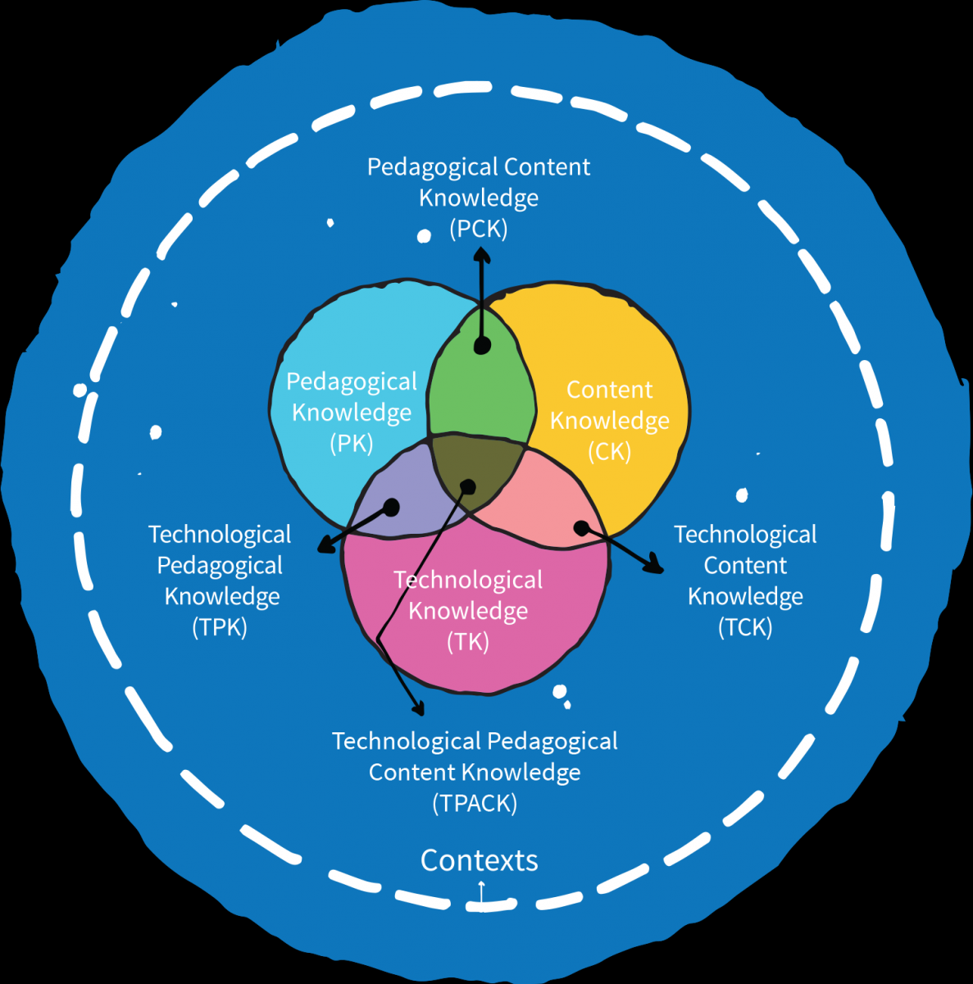
TPACK Model
Image based on
the original on TPACK.org
A relationship between technology, content, and pedagogy, and the purposeful blending of them is key.

Slide 23
TPACK – Steps to Take
Context
  Who are your learners?
  What are their learning needs and preferences?
  What knowledge of tech do they have?
  What tech is available to you?
Content
  What are you teaching?
  What should students be able to do at the end of a lesson?
Pedagogy
  What instructional strategies will you use?
Technology
  What technology will help your students achieve the instructional goals of the lesson?

Slide 24
Tech Station #1 Visualization
Technology Integration stations
Go to the course Bb page,
Open “Unit 1” folder,
Open “Tech Station #1 Visualization” folder.
03

Slide 25

Teaching by Visualizing with Technology – Infographic
Notes:
An Infographic is a method to represent data, information, statistics visually.

Slide 26
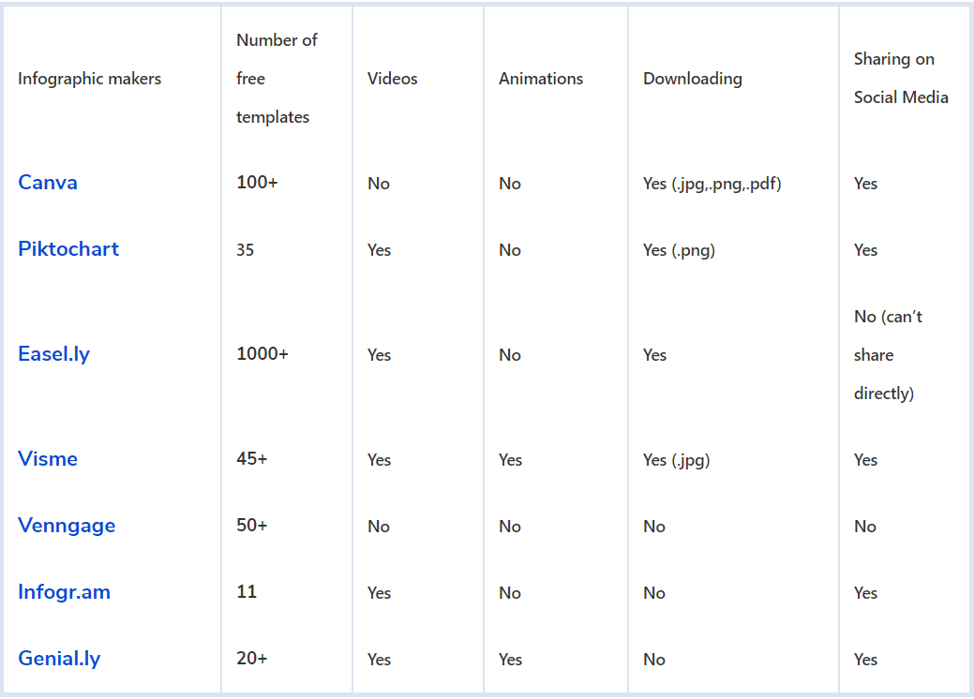
Teaching by Visualizing with Technology
Notes:
An Infographic is a method to represent data, information, statistics visually.
What’s more should we look at?

Slide 27

Teaching by Visualizing with Technology - Video
Explore:
  https://explore.org/livecams

Slide 28
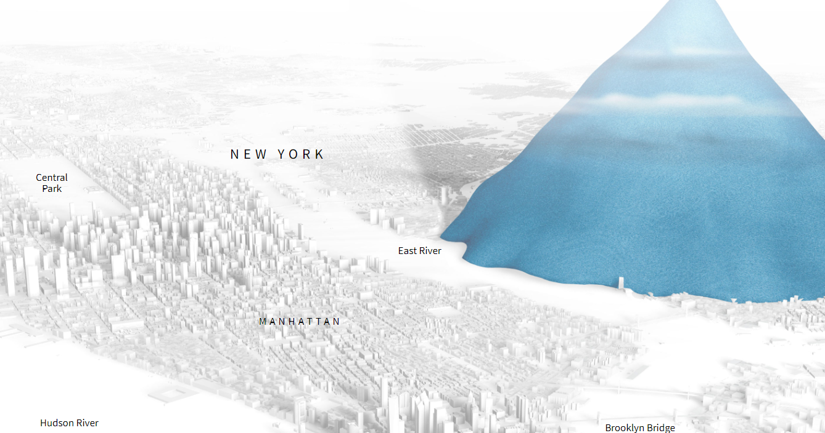
Teaching by Visualizing with Technology - Flash
Drowning in Plastic:
https://graphics.reuters.com/ENVIRONMENT-PLASTIC/0100B275155/index.html
IDD&E Lei Wang & Amber Walton 2021

Slide 29
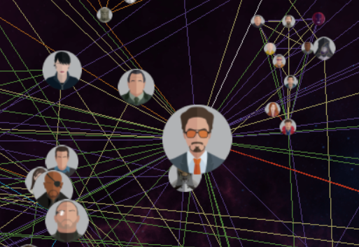
Teaching by Visualizing with Technology - Concept Mapping
Marvel Cinematic Universe:
  https://graphics.straitstimes.com/STI/STIMEDIA/Interactives/2018/04/marvel-cinematic-universe-whos-who-interactive/index.html

Slide 30
Learning by Visualizing with Technology
Video
Simulation
Mind Mapping
Virtual Reality

Slide 31
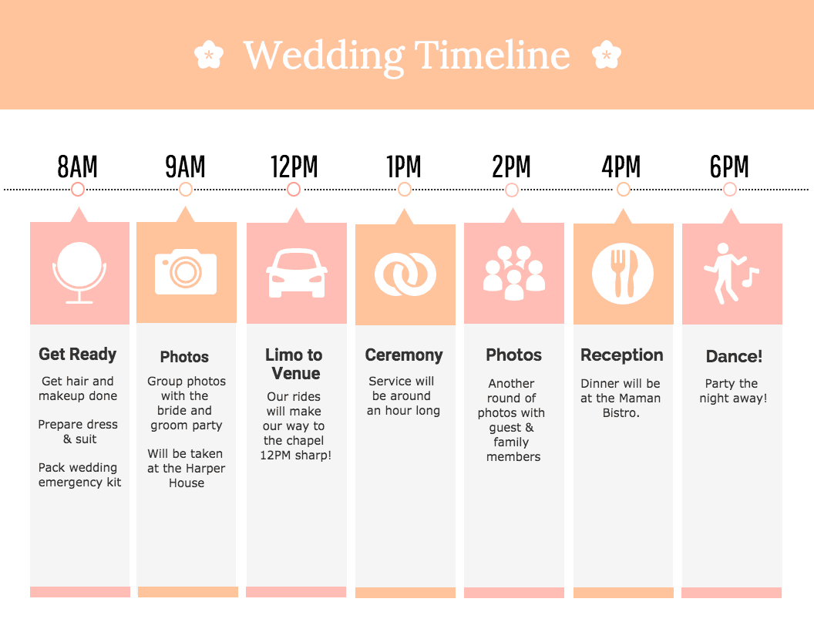

Tech Station #1.1 TimeLine
Notes:
What is a timeline?
Procedures?
Key point: order

Slide 32
Why TimeLine?
  For a variety of educational purposes:
  Record events from a story or a history lesson in a sequential format.
  Help students keep events in chronological order as they write summaries.
  For English language learners (ELLs), help them make connections and recognize patterns in a series or process.
  Teaching practices using Timeline https://ourjourneywestward.com/timelines-matter-when-teaching-history/
Notes:
http://www.readwritethink.org/files/resources/interactives/timeline_2/

Slide 33
Tech Station #1.1 TimeLine
Click on the Timeline link.
Read the three examples (Date, Time, Event).
Fill out your name and project title, then click START.
Create a timeline of your own interests, such as:
  History of events
  Procedure of an experiment
  Steps of an activity
  ….
Click on the timeline to create an event.
Fill out Label (time) and Short Description (Event), then choose an image for your event, and frame your image.
Add at least 6 events.
Notes:
http://www.readwritethink.org/files/resources/interactives/timeline_2/

Slide 34
Tech Station #1.1 TimeLine
When you are satisfied with your video, click Finish, then click Save Final to save it on desktop.
(optional) Upload it to your Wix, and insert it in your first Tech Design Case page.
Upload your Timeline to the Discussion Board – Timeline, and:
Share your evaluation of this tool regarding (select 3 to answer):
  Strength and areas of improvement
  Accessibility
  Alternative products
  How could you use this tool in your classroom to facilitate your students’ learning?
  Can you write a content standard (e.g. Common Core, Next Generation Science Standards, etc.) that could be used to help students learn?
Notes:
http://www.readwritethink.org/files/resources/interactives/timeline_2/

Slide 35
Tech Station #1.2 PowToon
Click on the PowToon link (https://www.powtoon.com/).
Click on the blue START NOW button.
Follow the instructions, register an account with your email account.
Click MORE TEMPLATES to explore various templates.
Choose one template in the EDUCATION and TEACHER category, then click “Use”.
Modify the template to create a 5 slides self-introduction to your future students.
  Customize your own animation video.
  Double click any text or object to edit.
  View the right-side bar to explore more edit options.
  Use the right-side bar to add more elements, like graphics.

Slide 36
Tech Station #1.2 PowToon - Submission
Explore the various functions of PowToon, voiceover, collaboration…
When you are satisfied with your video, click PREVIEW & EXPORT on the top right, then click EXPORT.
Click the blue button CREATE to create your PowToon page. Fill out the information required in the next page.
Check your video in your page, notice that you can play it as a movie or a slideshow.
Click EXPORT, then click YouTube, to access the webpage to upload to the website.
Click NEXT, and then click UPLAD WITH WATERMARKS.
You will receive your link in your email from Powtoon Awesomeness.
Remember to ADD the link to your Wix.

Slide 37

Recap
Were you paying attention?

Slide 38
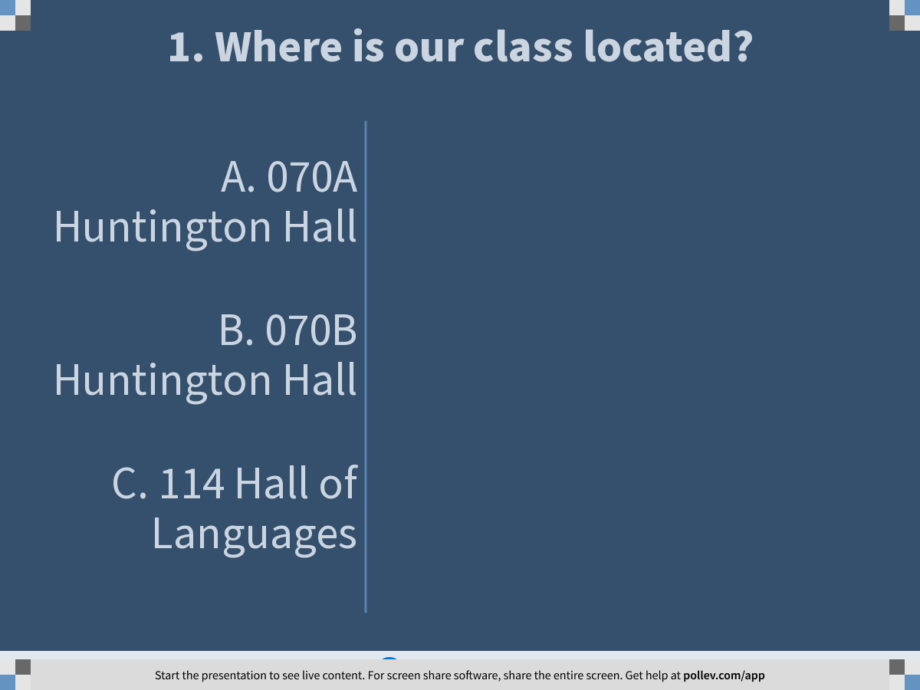
Notes:
Poll Title: 1. Where is our class located?
https://www.polleverywhere.com/multiple_choice_polls/JMuTTRKntv7FLkZGOqRqs

Slide 39
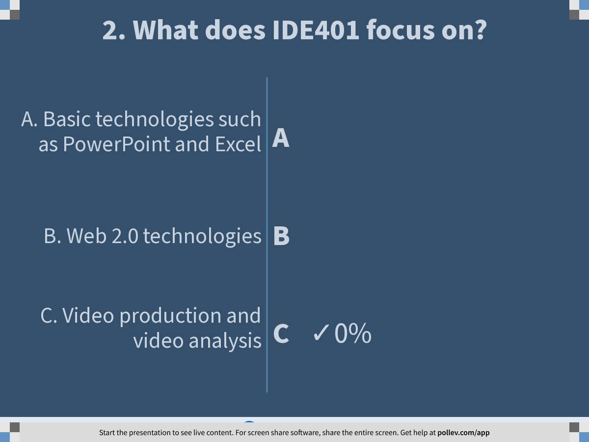
Notes:
Poll Title: 2. What does IDE401 focus on?
https://www.polleverywhere.com/multiple_choice_polls/Q4kj9BEOQpFsQpUt27zLE

Slide 40
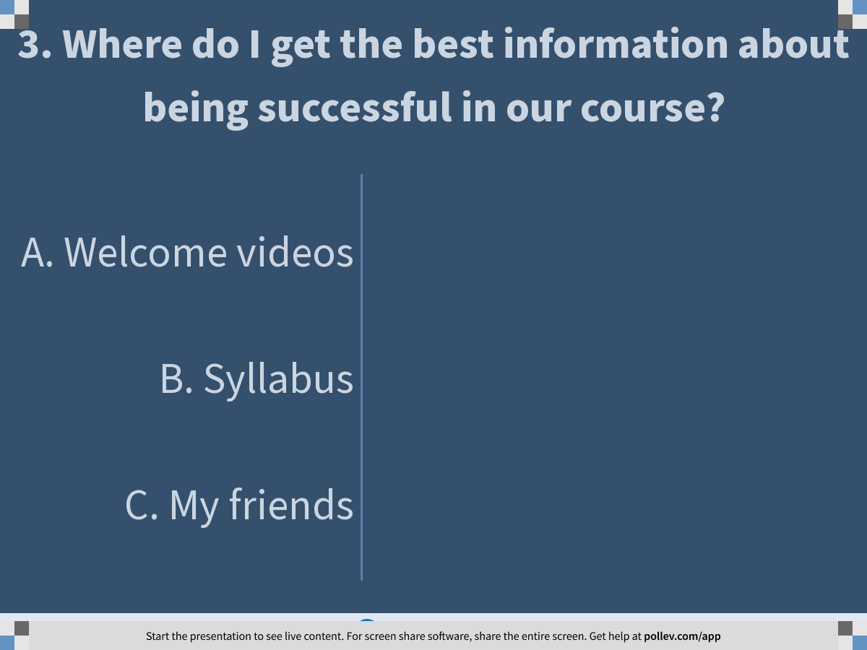
Notes:
Poll Title: 3. Where do I get the best information about being successful in our course?
https://www.polleverywhere.com/multiple_choice_polls/Mg1E78Grh0hXlvx8HlOtY

Slide 41
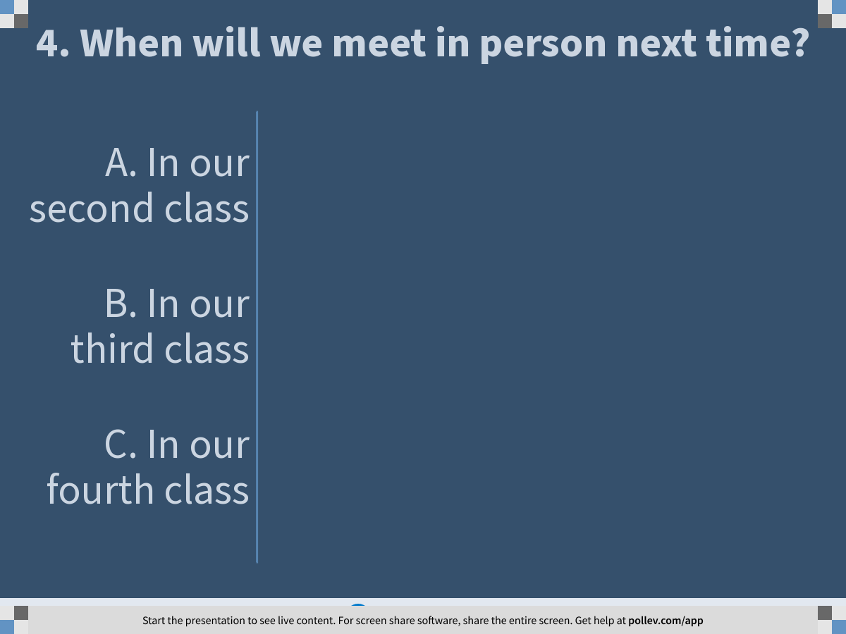
Notes:
Poll Title: 4. When will we meet in person next time?
https://www.polleverywhere.com/multiple_choice_polls/FVgpaULfnvPhouWjUEf9F

Slide 42
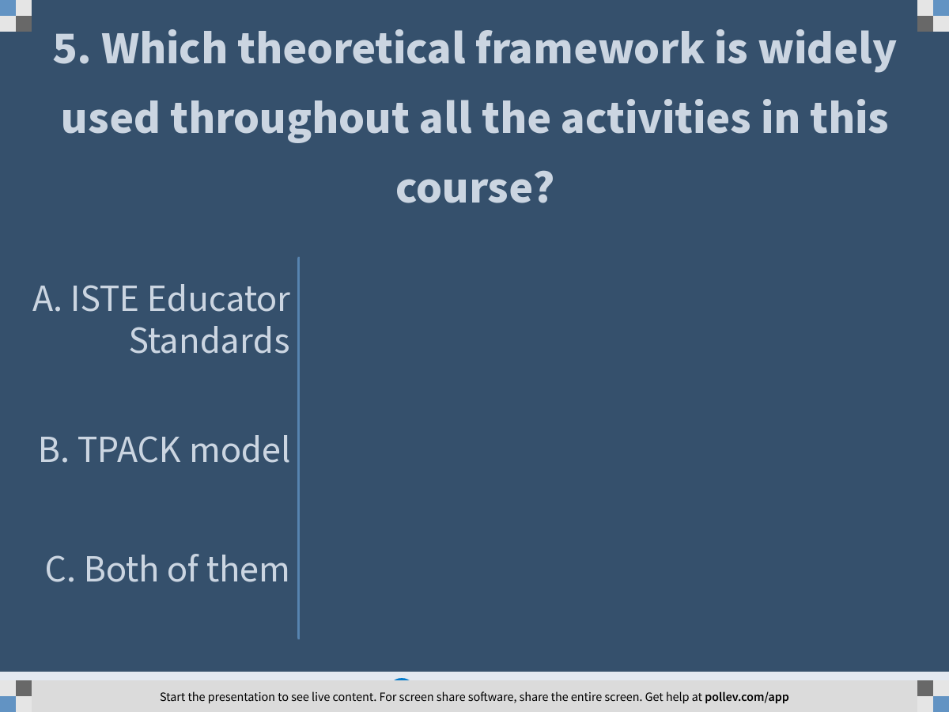
Notes:
Poll Title: 5. Which theoretical framework is widely used throughout all the activities in this course?
https://www.polleverywhere.com/multiple_choice_polls/USt1RRNrrnDjvlN9PqtH9

Slide 43
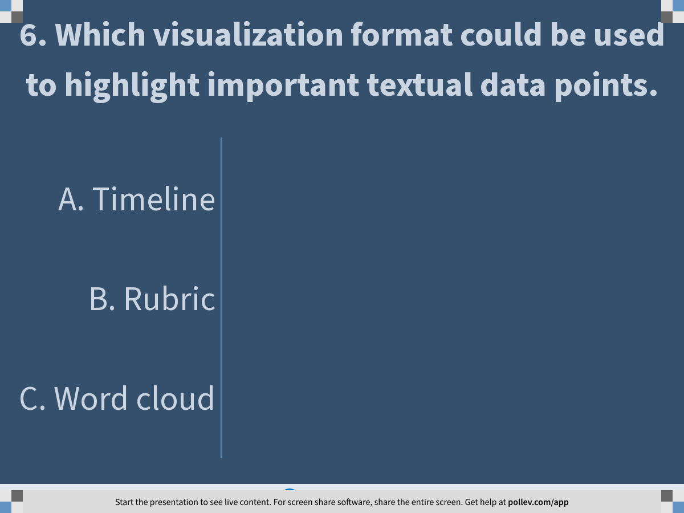
Notes:
Poll Title: 6. Which visualization format could be used to highlight important textual data points.
https://www.polleverywhere.com/multiple_choice_polls/fic2ASffGbVV7gnYOe5tI

Slide 44
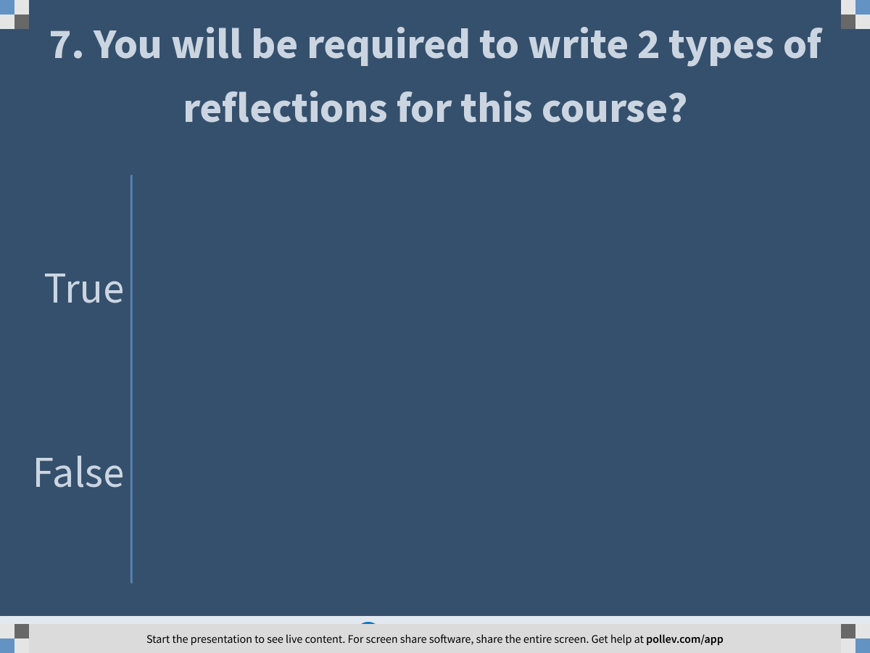
Notes:
Poll Title: 7. You will be required to write 2 types of reflections for this course?
https://www.polleverywhere.com/multiple_choice_polls/s9UmD6t96SEX6xmTBMZZC

Slide 45
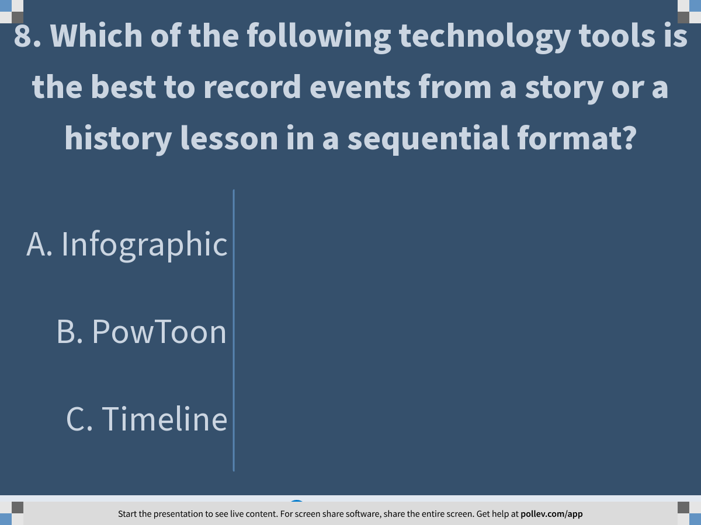
Notes:
Poll Title: 8. Which of the following technology tools is the best to record events from a story or a history lesson in a sequential format?
https://www.polleverywhere.com/multiple_choice_polls/lYmt0kqJot0T7yX9Kn1qs

Slide 46
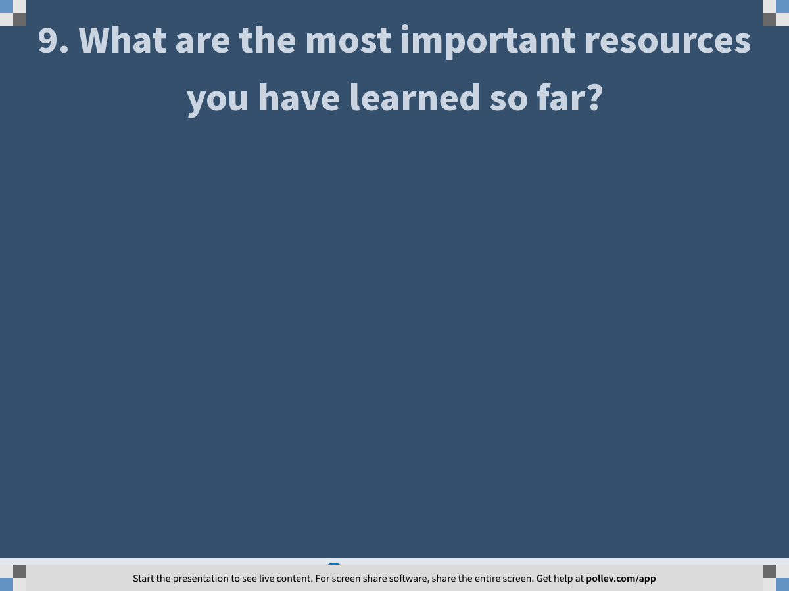
Notes:
Poll Title: 9. What are the most important resources you have learned so far?
https://www.polleverywhere.com/free_text_polls/haqU6qHhA6w0NGvFQq7KM

Slide 47
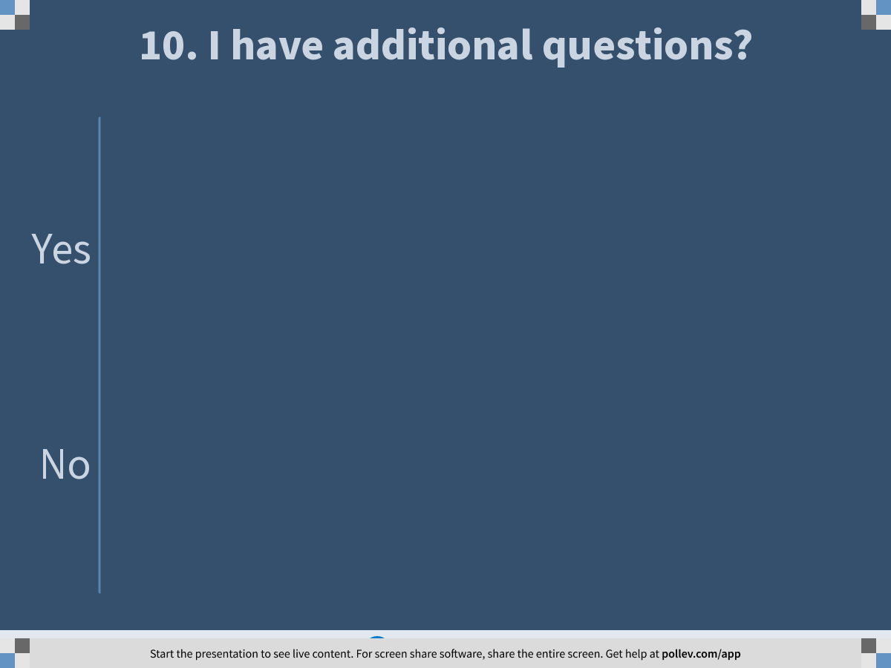
Notes:
Poll Title: 10. I have additional questions?
https://www.polleverywhere.com/multiple_choice_polls/ttkzdOijiaqMpcFsniCSl

Slide 48
Assignment
Tech Design Case #1
04

Slide 49
Technology Integration Portfolio This week
Technology Integration Portfolio - 5 pages Draft Site (in class, 2/11)
Self-introduction and overview of the site (in class, 2/11)
Create a PowToon movie (in class, 2/11)
One technology integration design case - Case #1, (Assignment, 2/17)

Slide 50
Tech Design Case #1 Visualizing with Technology
Due 2/17, 11:59pm
In this assignment, you will design a learning activity with one or more visualization tools you learned in today’s tech station and clearly describe how the instructional tool will be used in the unit to help the students achieve the desired learning objectives. You could also reflect on the tool in a thoughtful manner, such as to evaluate its strengths and weaknesses. Your description of this learning activity must include:
A content standard for the learning activity
The name and the link to the technology tool used in the activity
One or more screenshots or pictures of the tool used in this activity
A description of the teacher's role in this activity
A description of the students' roles in this activity
A short reflection of how this technology tool supports this learning activity (maximum 100 words).

Slide 51
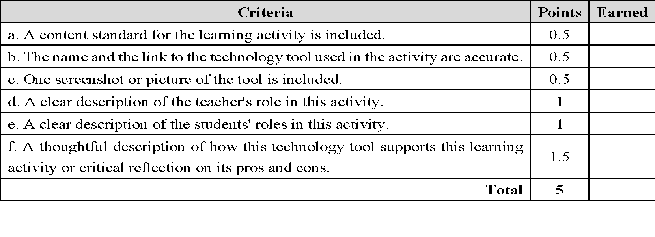
Tech Design Case #1 Visualizing with Technology
Due 2/17, 11:59pm
Open a new Word file to write the design case.
When you finish, save your file and click Export-Create PDF Document, then SAVE it to the desktop.
Submit your PDF file to the UNIT1 – Assignment Dropbox by the due date.
Upload the PDF file to your Wix.
Read the Grading Criteria below for detailed information about the required components.

Slide 52
Citations:
Cindy. (2017,August 13). Why Timelines Matter When Teaching History. Retrieved from https://ourjourneywestward.com/timelines-matter-when-teaching-history/
Dylan Rodgers, D. (2018, January 19). The TPACK Framework Explained (With Classroom Examples). Retrieved from https://www.schoology.com/blog/tpack-framework-explained

